Slide 1
Inuksuit
A Legacy
Inuit Cultural Identity
A Global Symbol of Perseverence

Slide 2
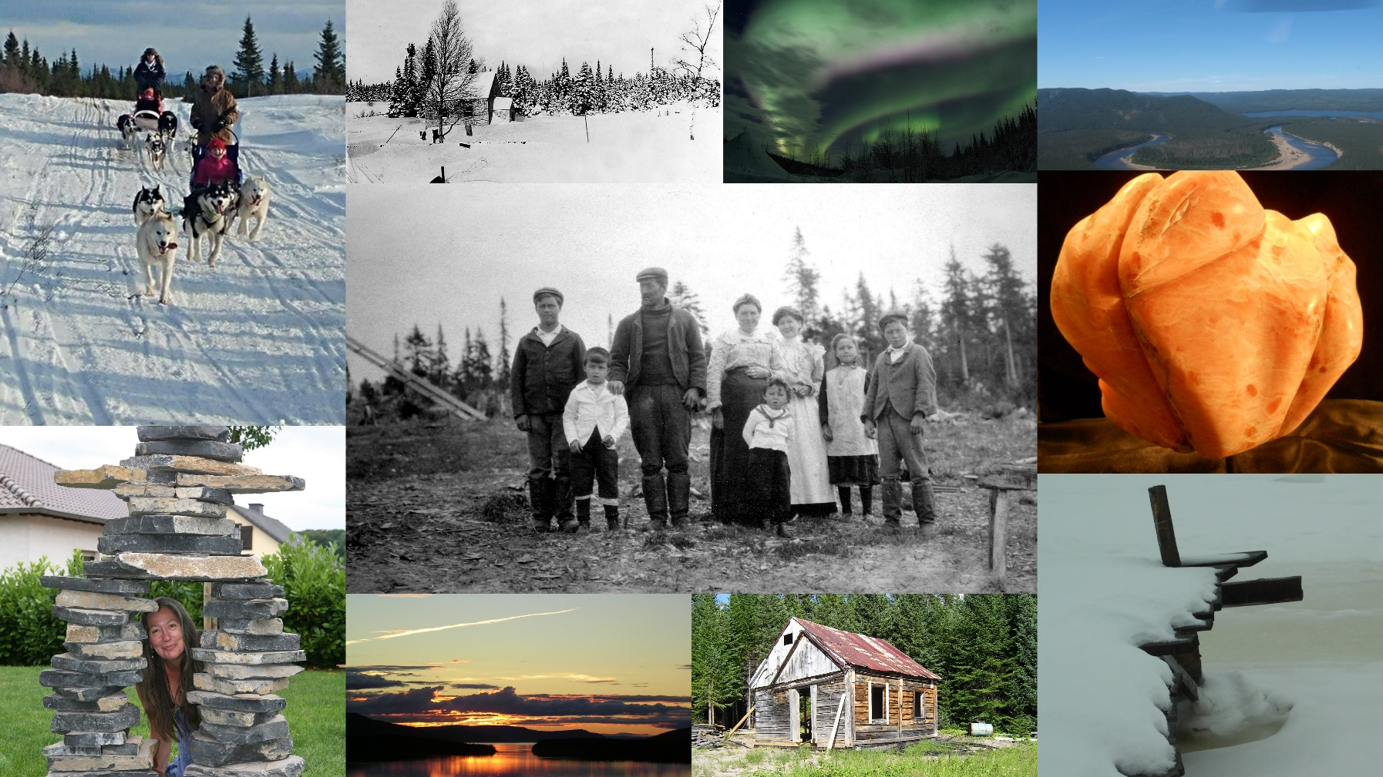
Cultural Identity

Slide 3
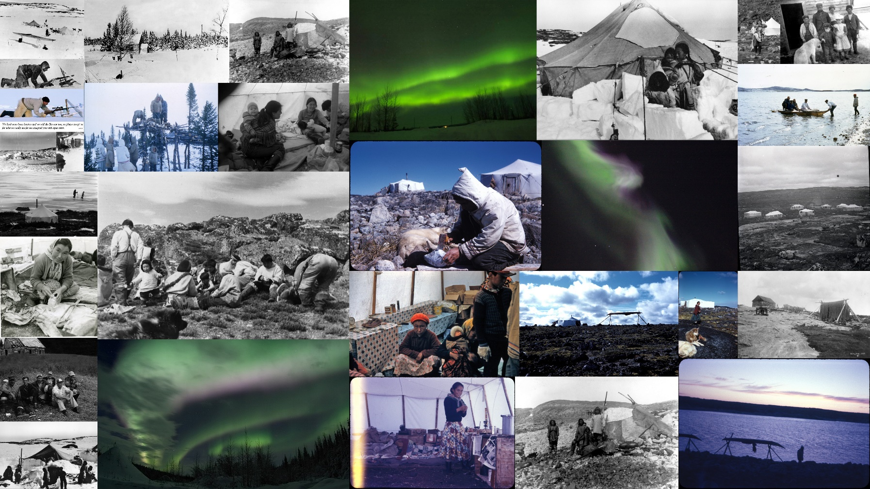
Bringing yesterday into the present.

Slide 4
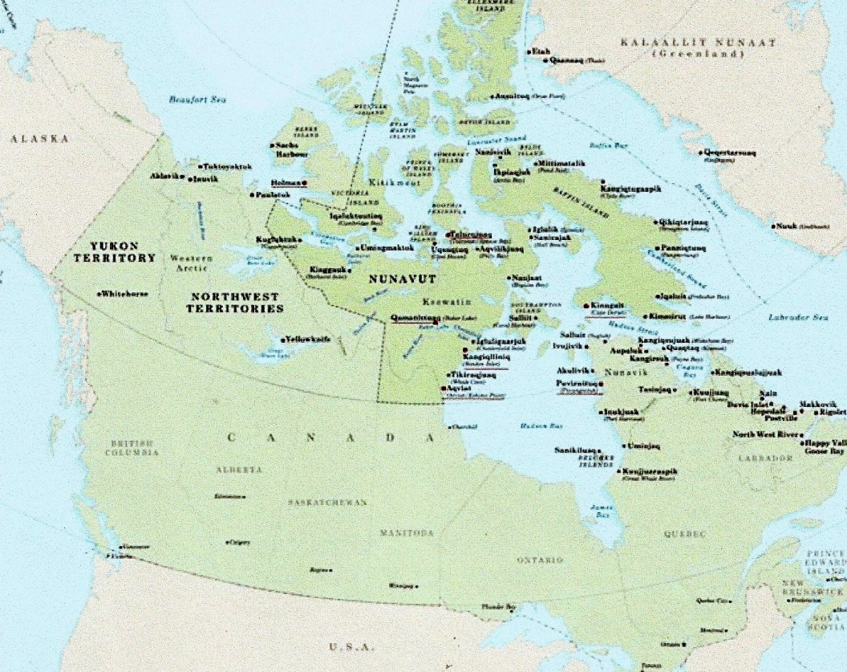
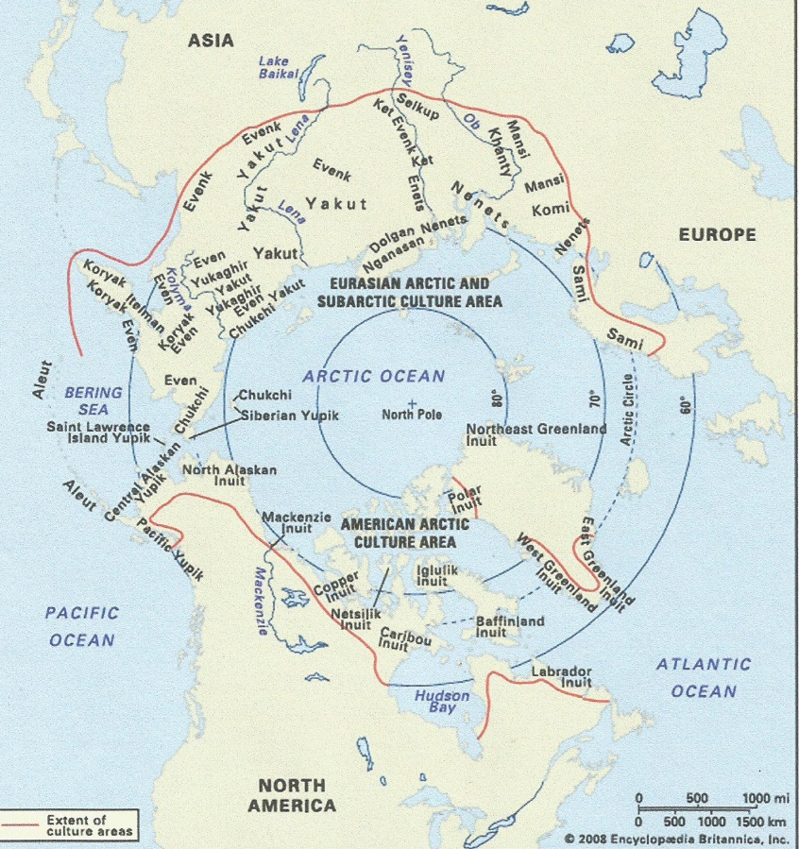
To give you an idea who and where.
Geographical location of Inuit
Territories.

Slide 5
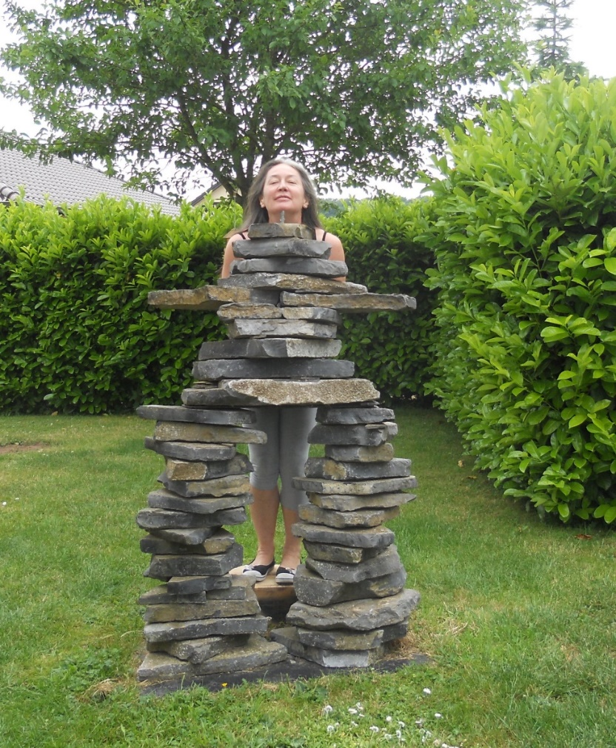
Travels with my Inukshuk.

Slide 6
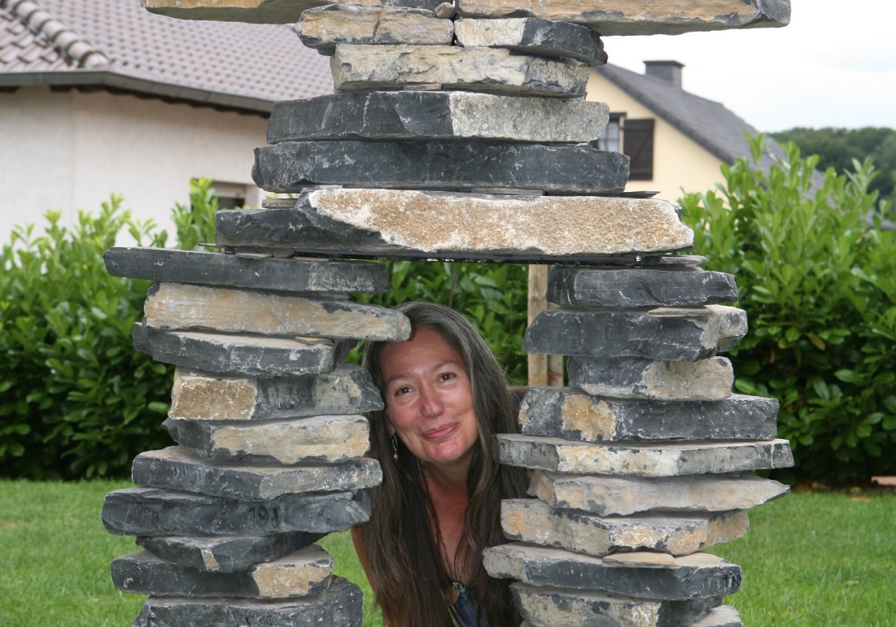
My inukshuk has taken me many places, geographically and spiritually.
She has become part of my identity. Tenacious, unyielding yet so very open to the elements. In her case the elements are the wind, rain, sun and cold. The snow that protects her, the ice that challenges her. In my case they are the circumstances of life and their consequences. The inukshuk adapts by shifting her weight, hosting lichens, harbouring insects and playing hostess to the birds that visit my garden. This describes my life as a child, a woman, an artist. I was extremely honoured when asked to create an Inukshuk for the ICC. It is with great pleasure and a privilege that I assume this task.

Slide 7
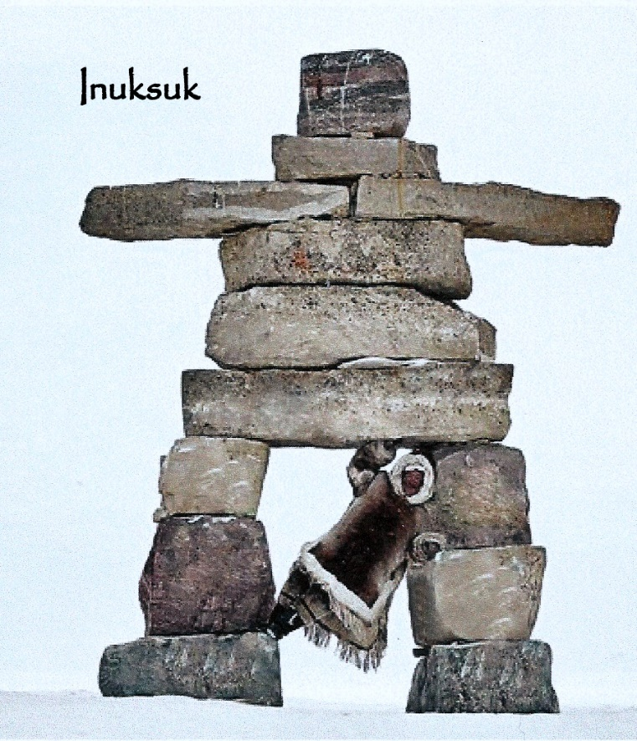
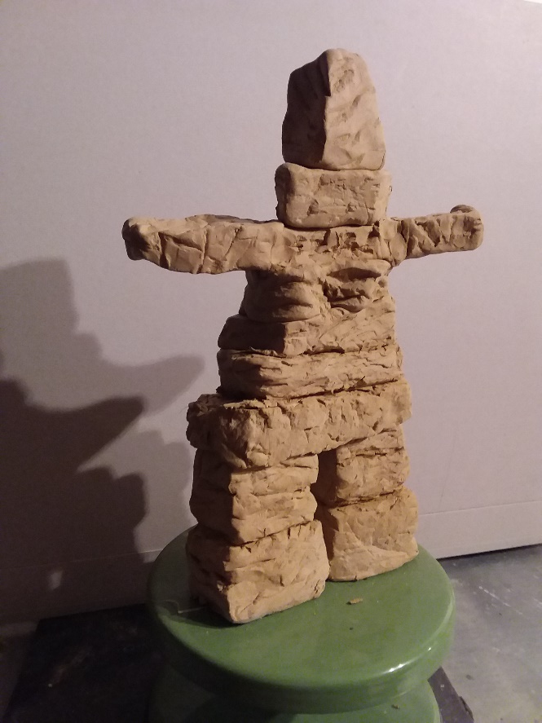
The project
Depiction of project
Scale model. Completed height 3 metres

Slide 8
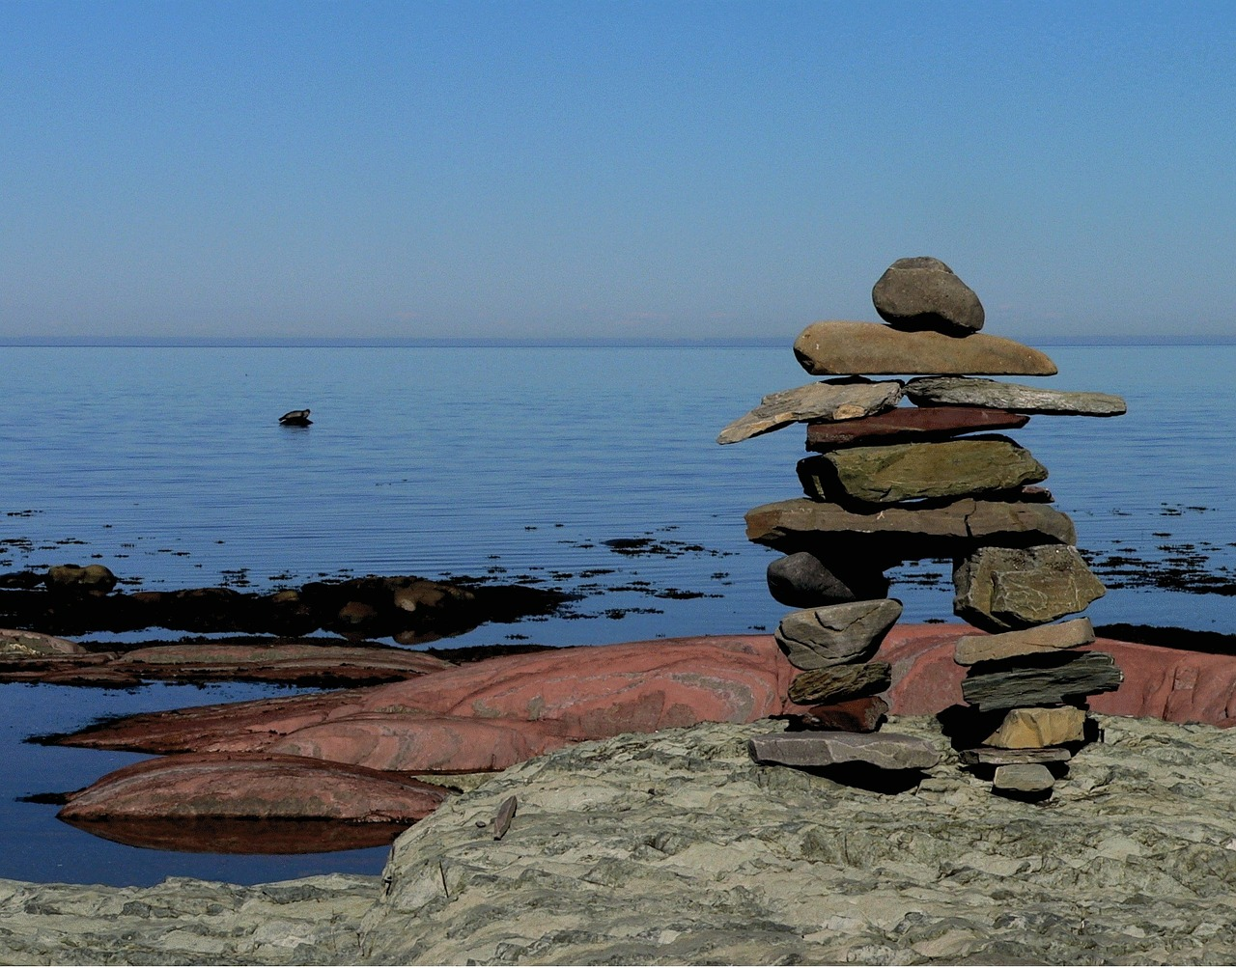
Inuksuit, Innunguaq, Tulitiit, Turaaruit and more.

Slide 9
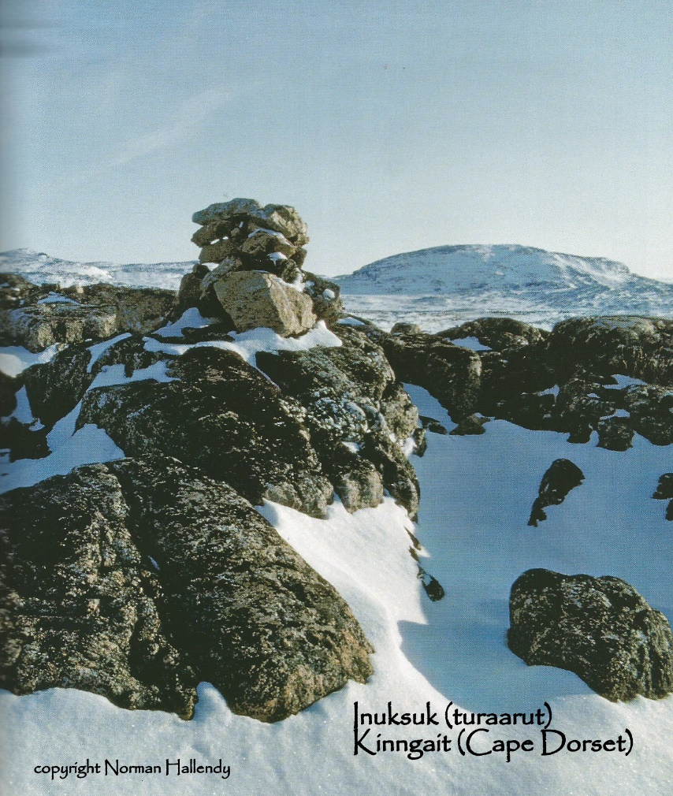
Showing the way.

Slide 10
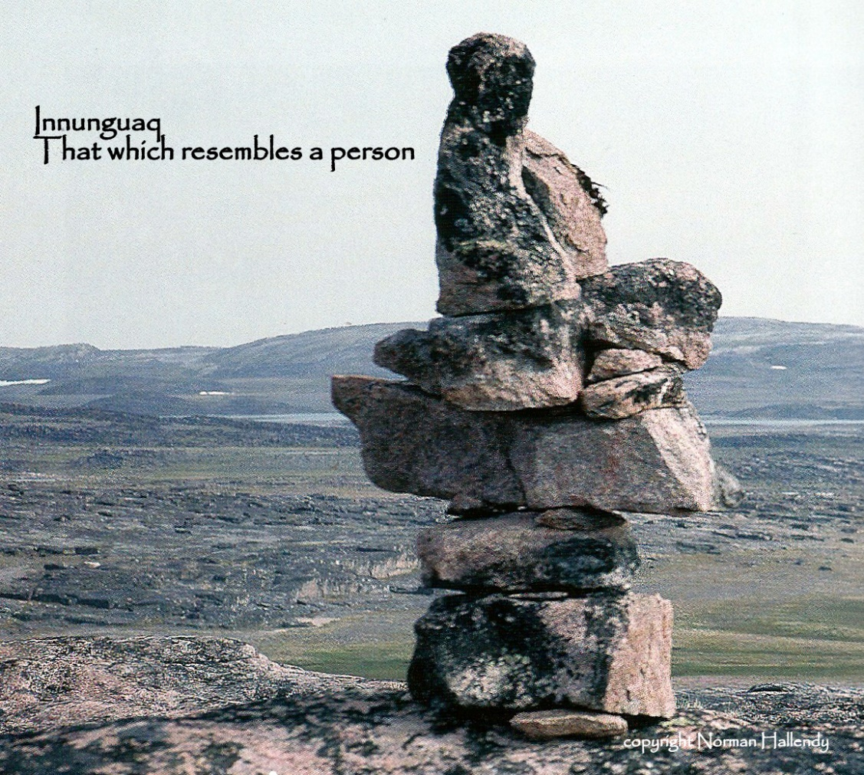
We were here.

Slide 11
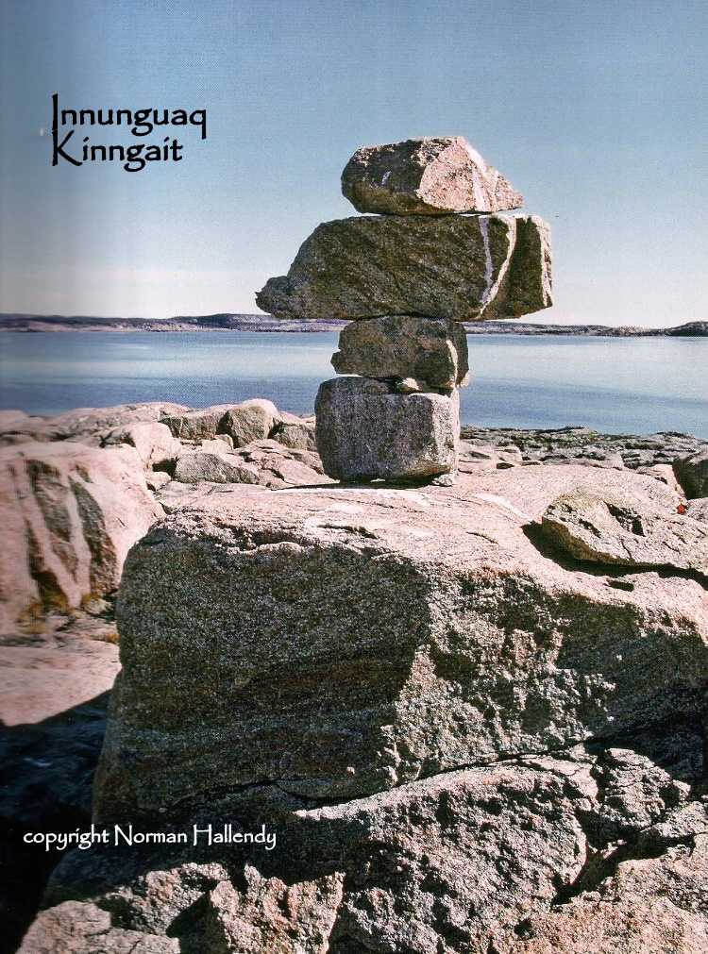
Keep going…

Slide 12
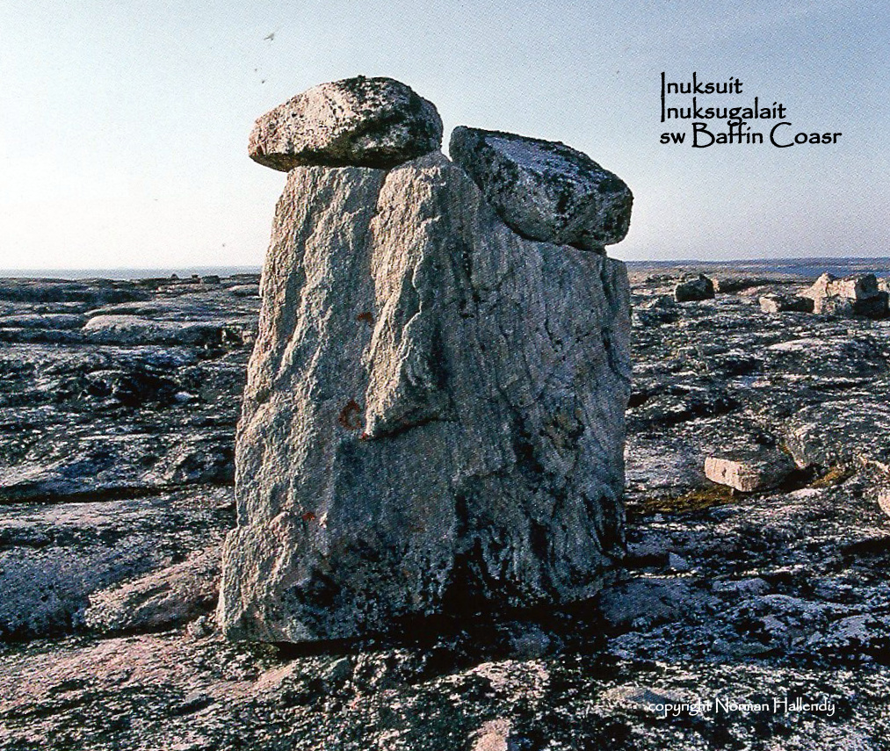
Keeping company.

Slide 13
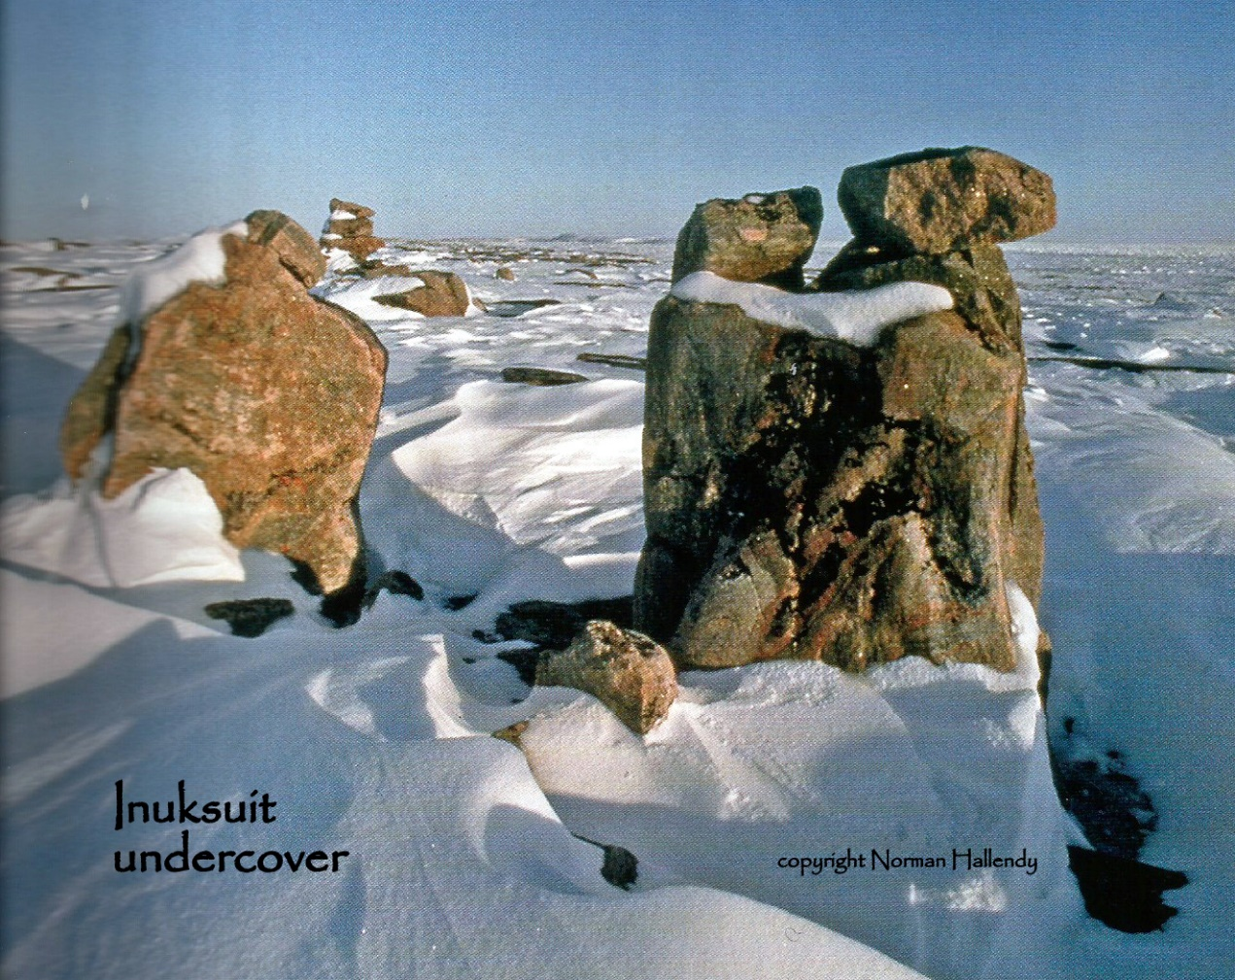
Winter wayfinders.

Slide 14
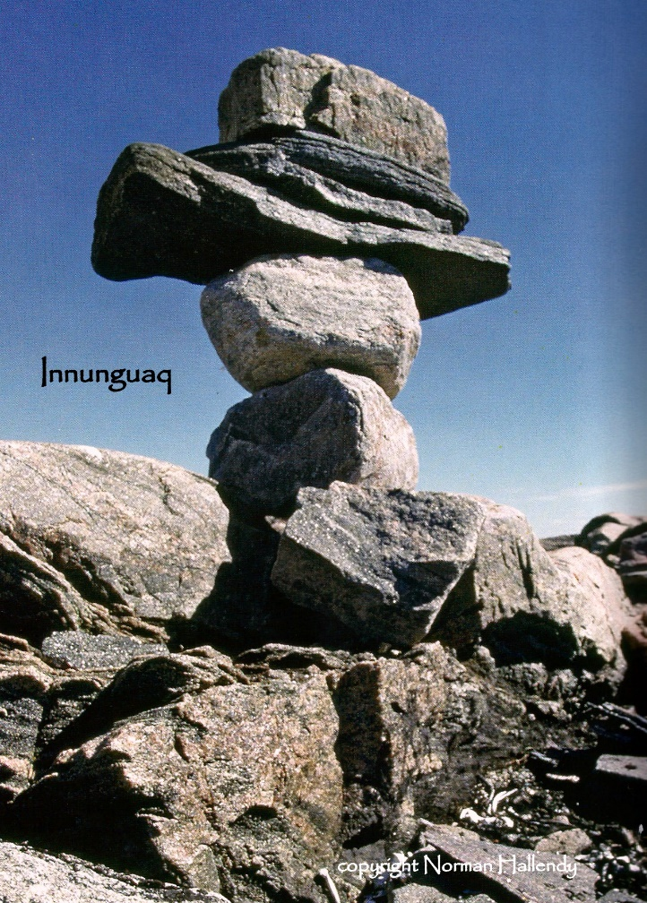
You can camp here!

Slide 15
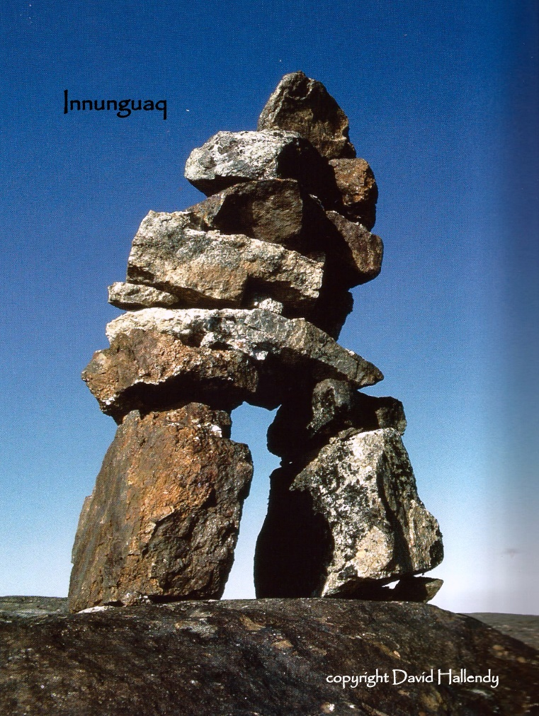
Follow me.

Slide 16
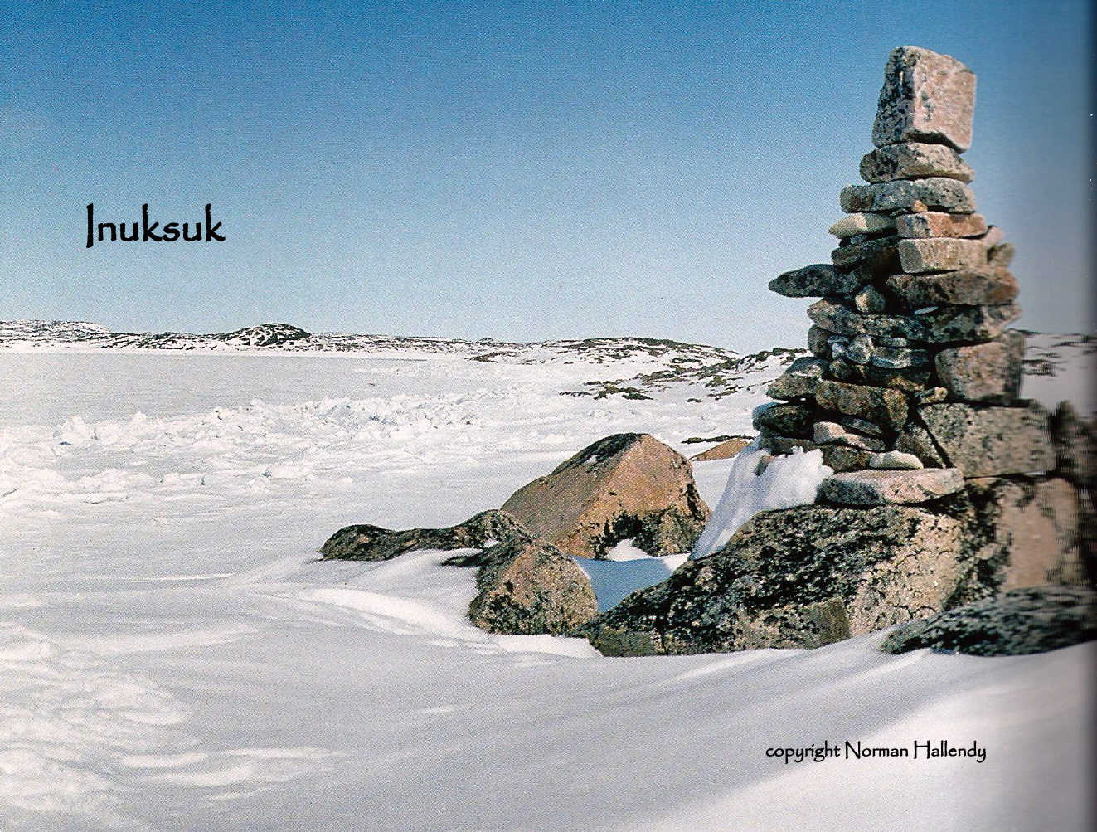
I have food!

Slide 17
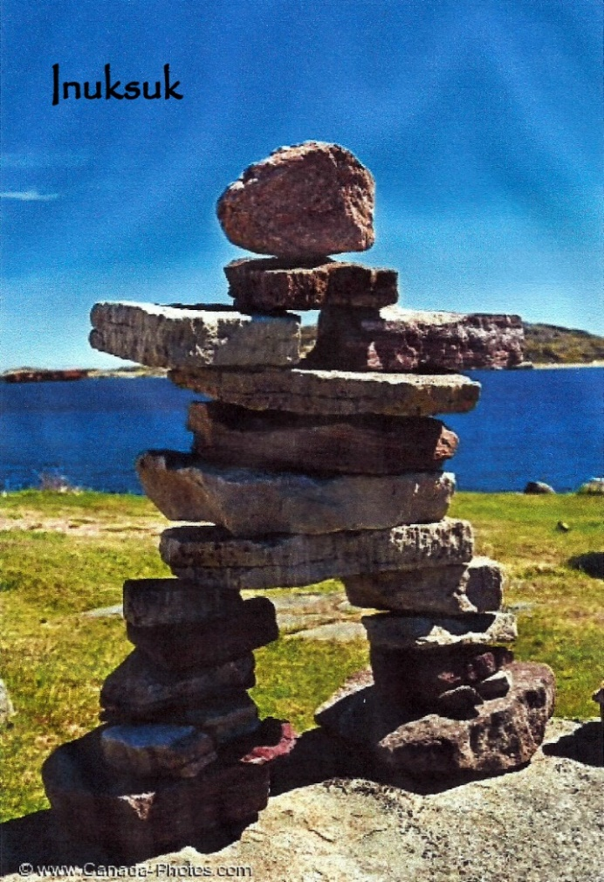
Welcome!

Slide 18
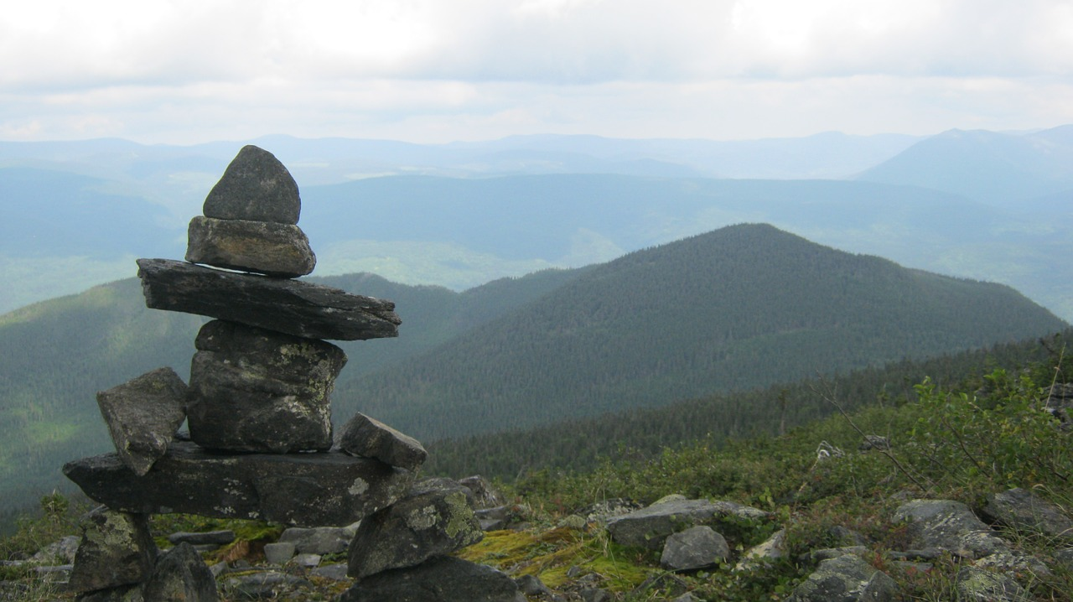
Watching…

Slide 19
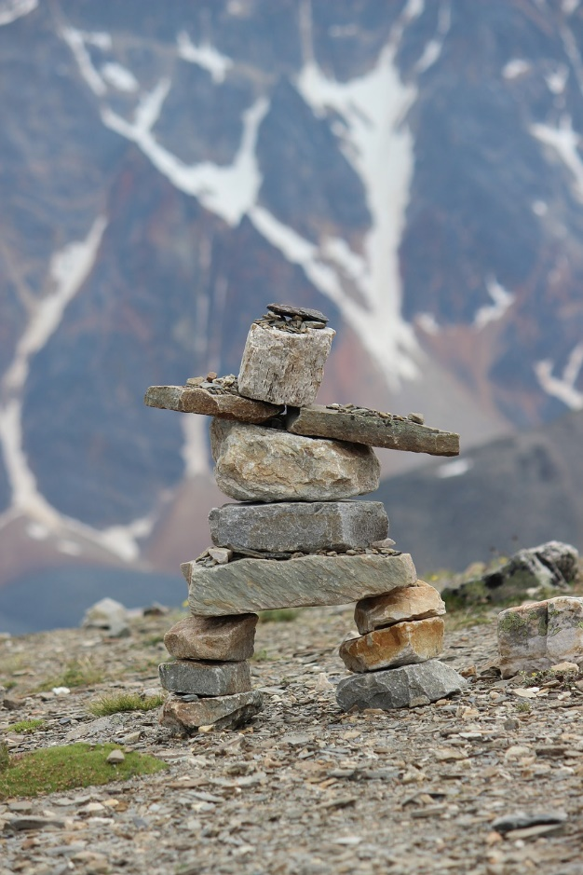
We are over here!

Slide 20
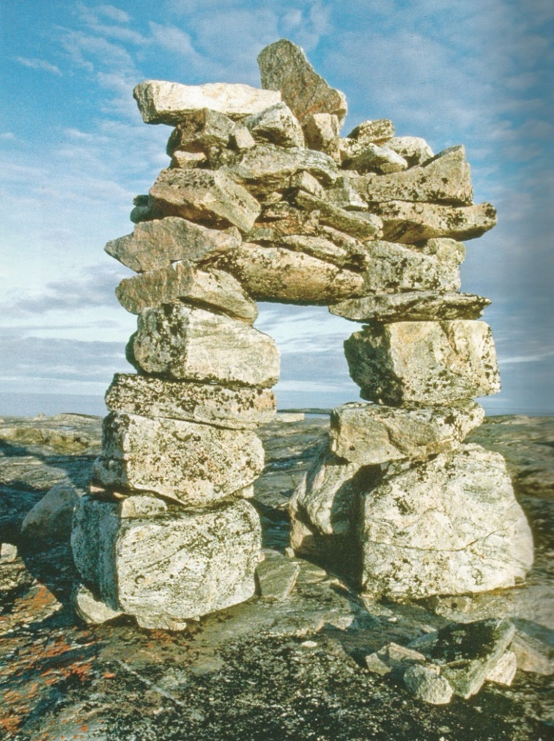
It’s that way!

Slide 21
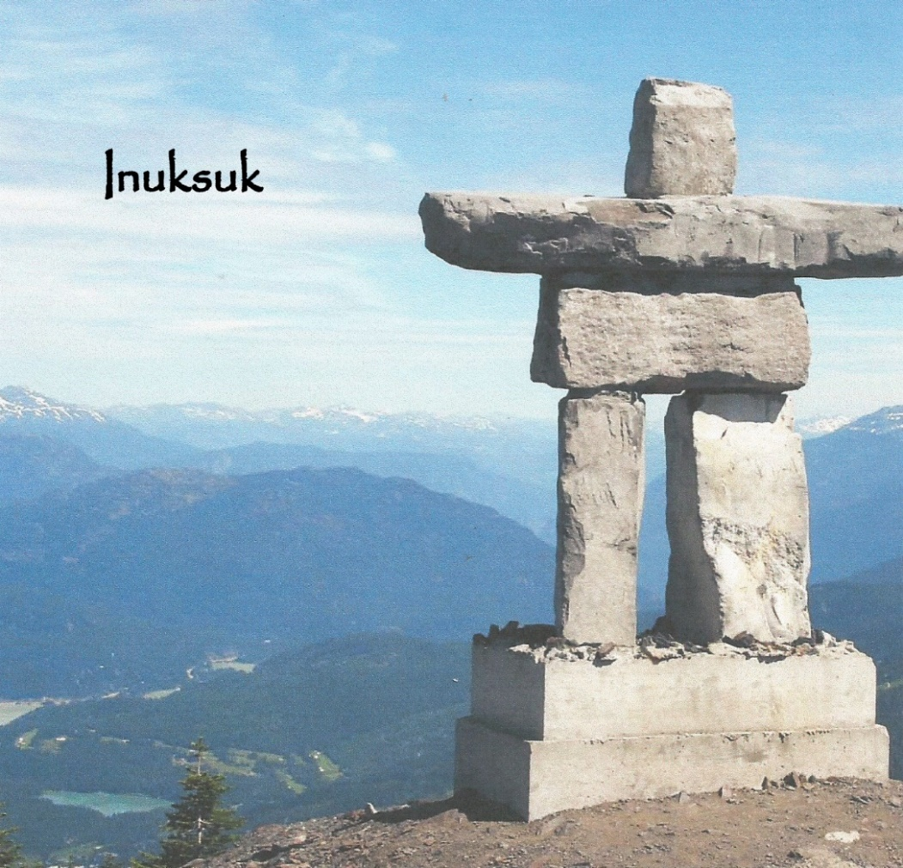
Standing guard.

Slide 22
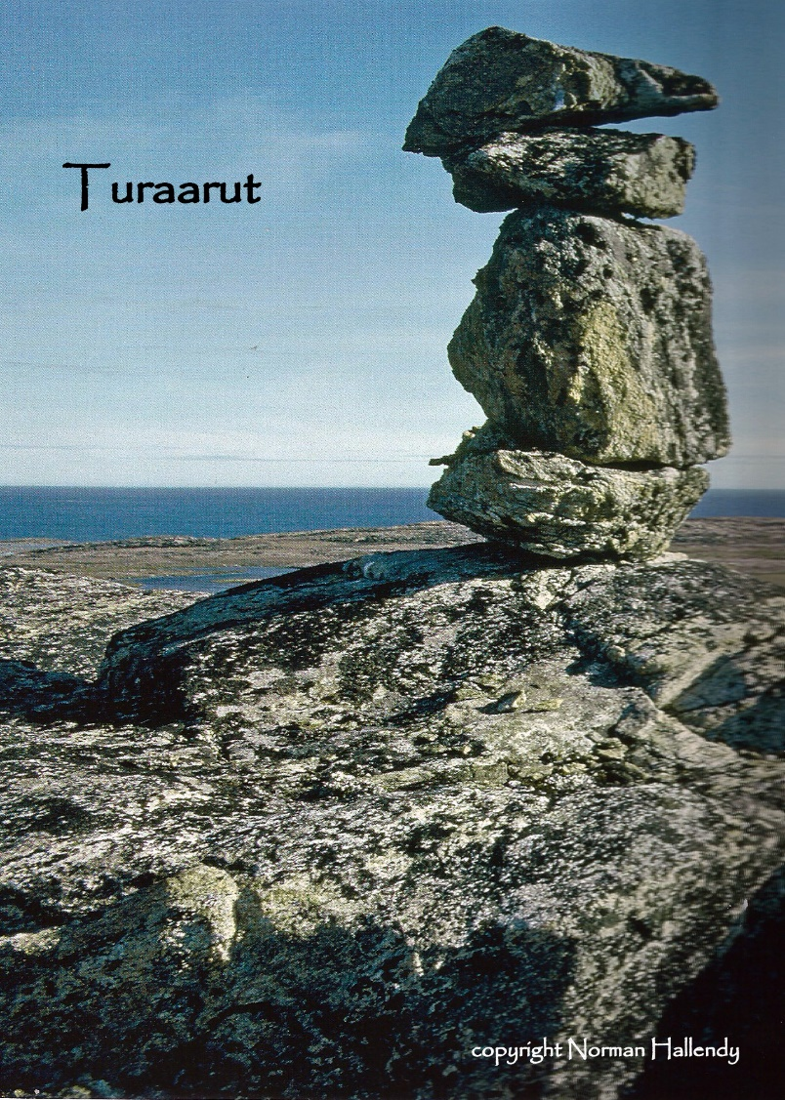
Showing the way.

Slide 23
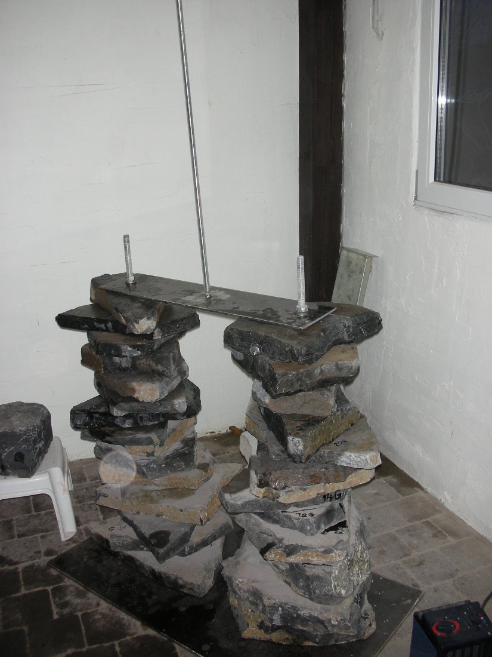
In the beginning.
Assembly of 500kg of shale on an improvised armature.

Slide 24
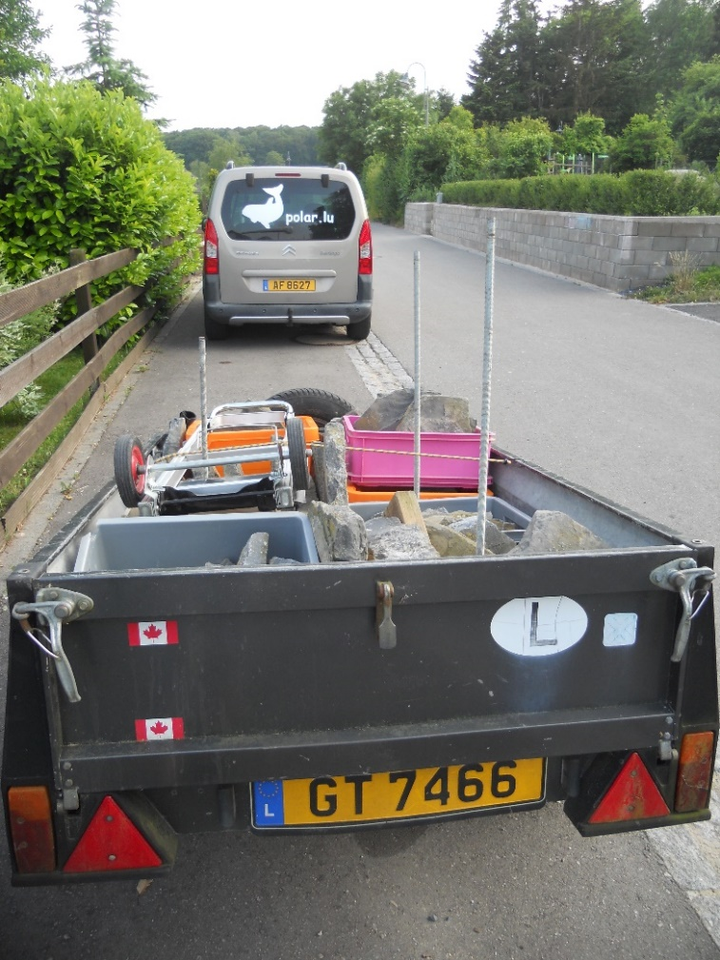
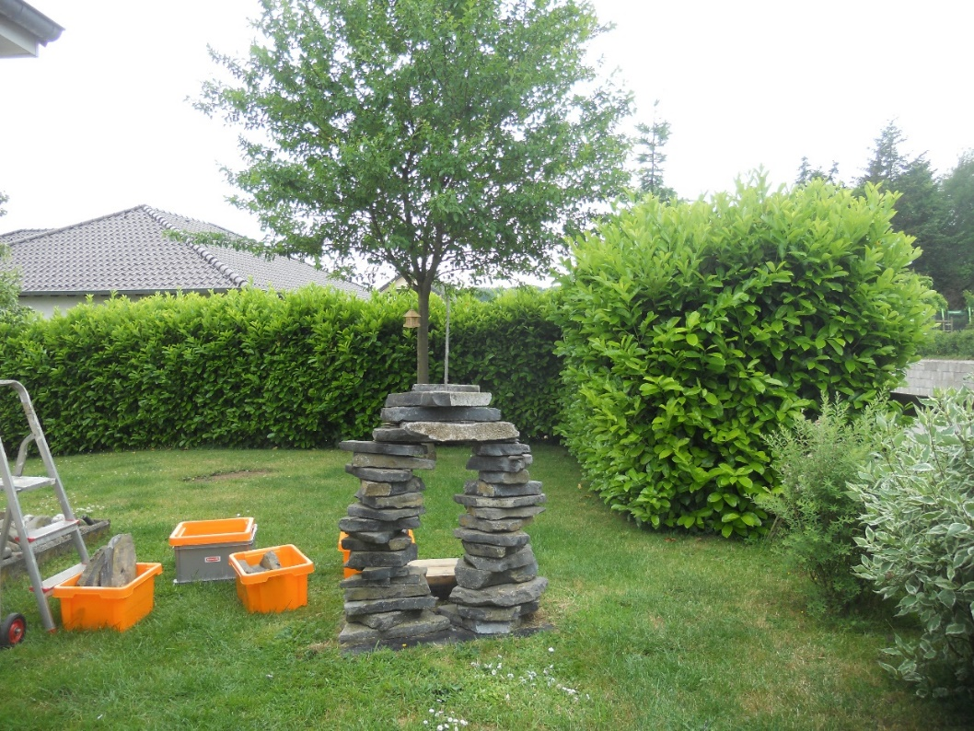
On the Road Again

Slide 25
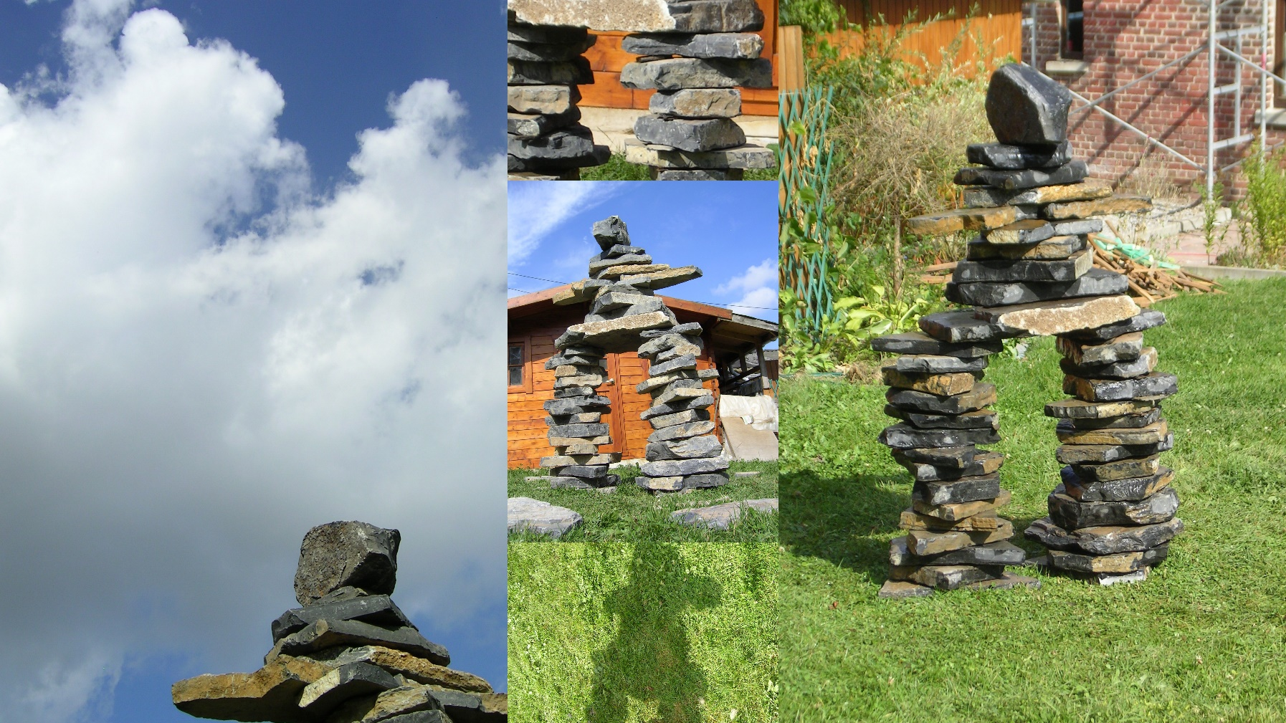
Maredsous, Belgium

Slide 26
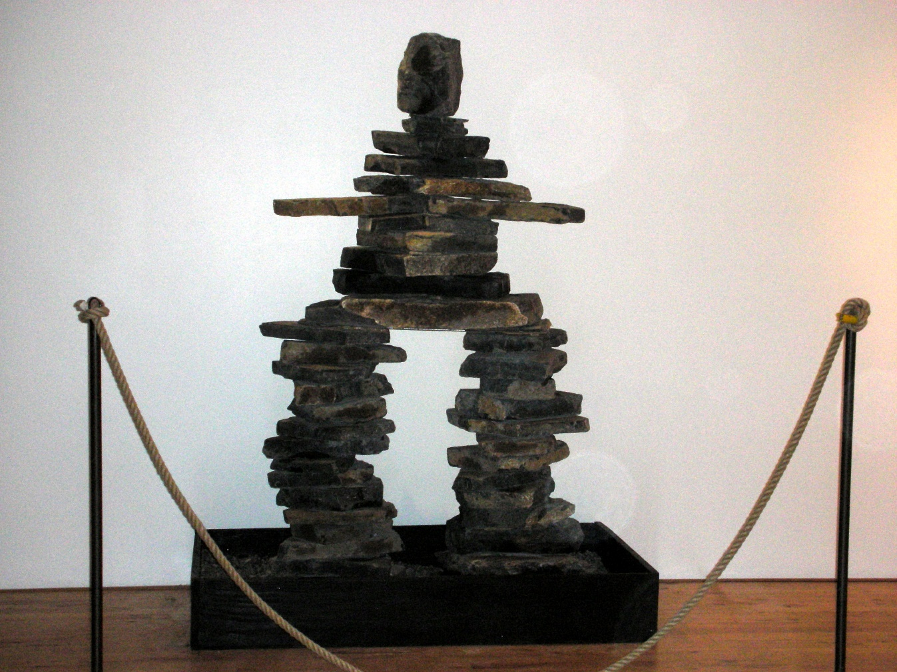
Brussels, Belgium

Slide 27
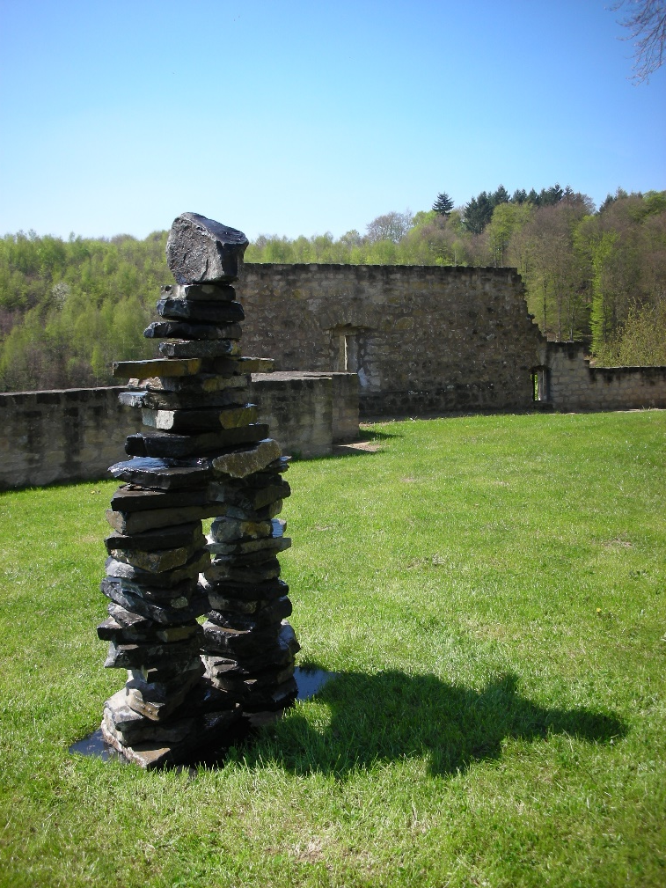
Larochette, Luxembourg

Slide 28
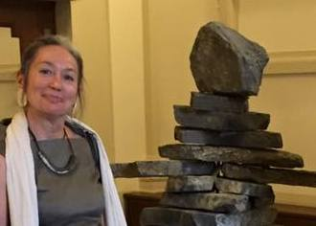
Cercle Cité, Luxembourg

Slide 29
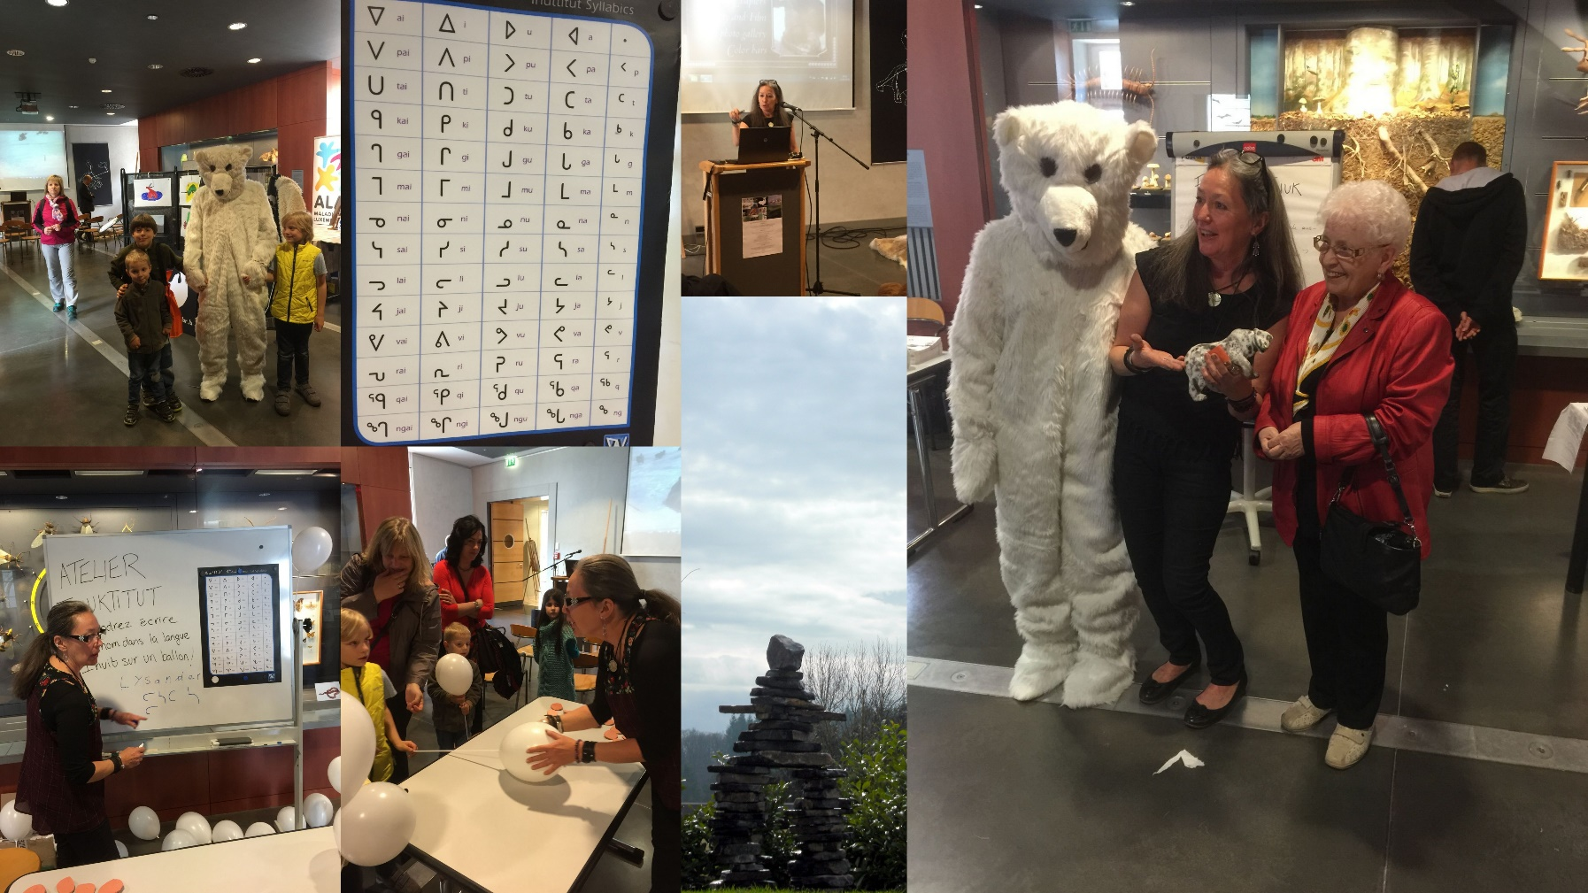
Teaching, learning, sharing with my inukshuk.

Slide 30
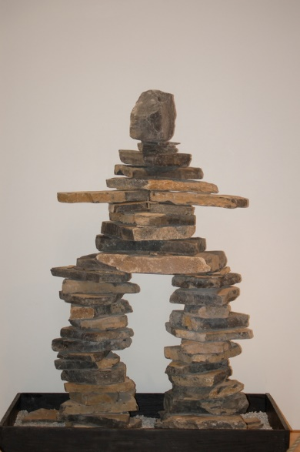
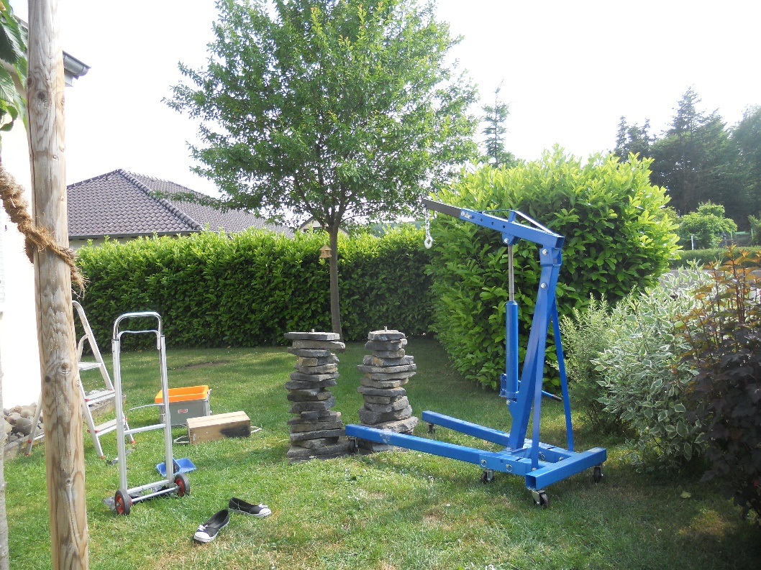
Here, there,

Slide 31
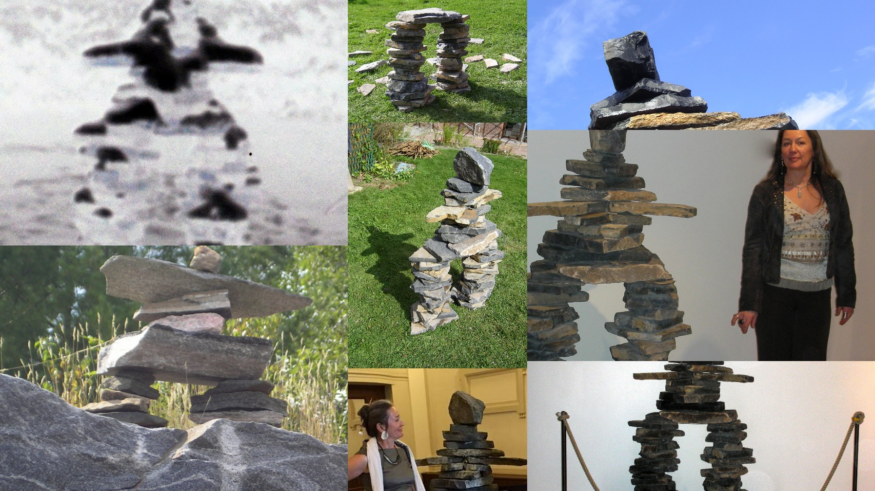
and everywhere….

Slide 32
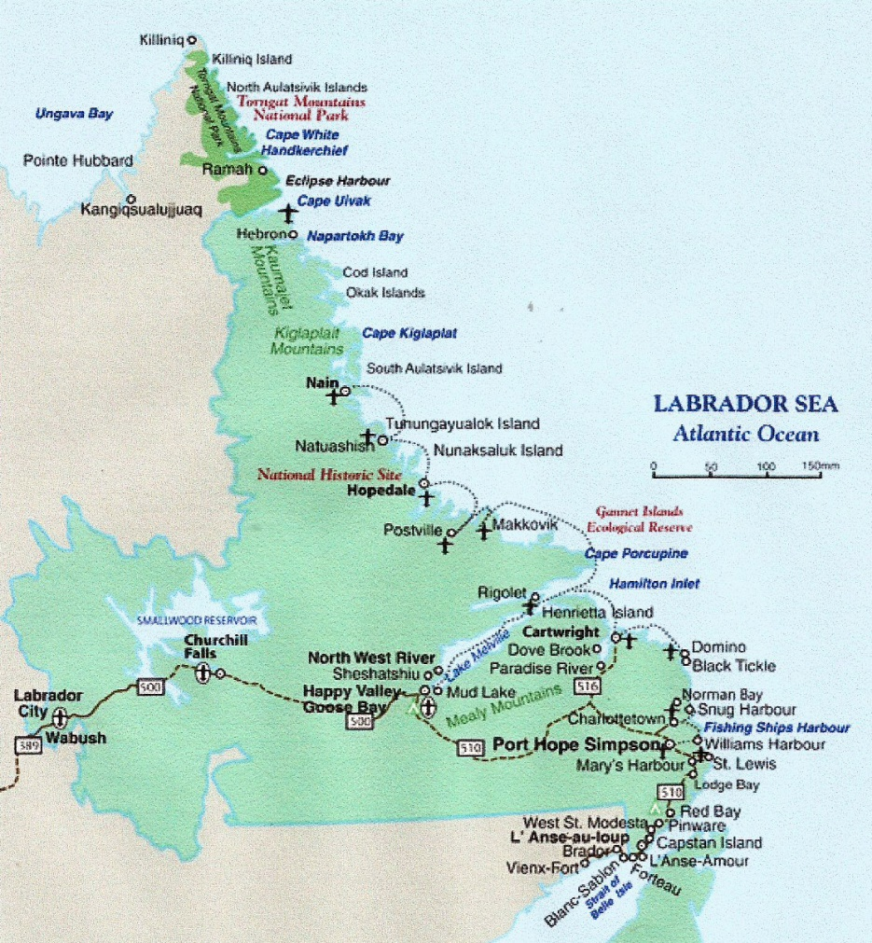
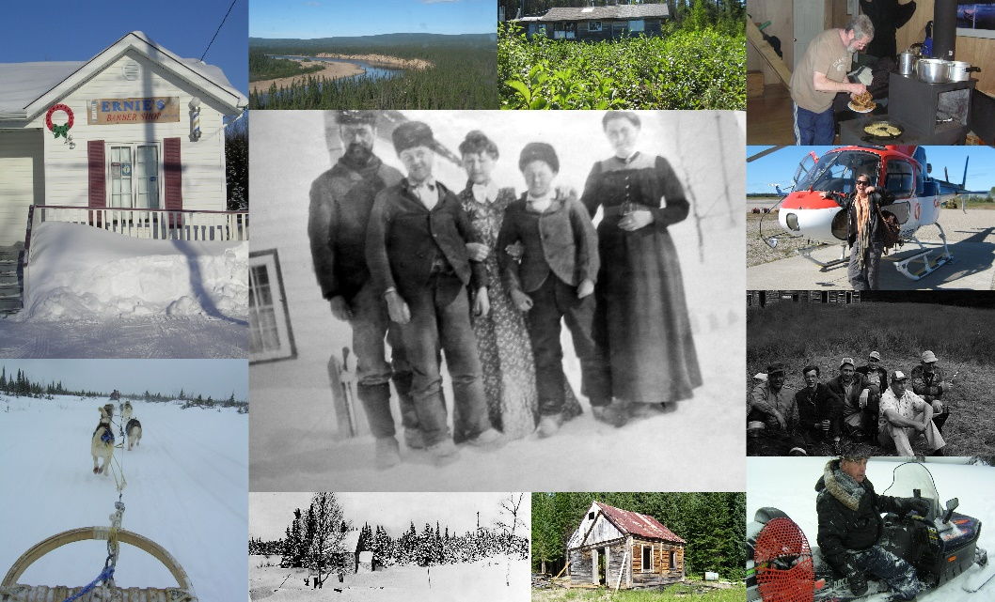
Home, never alone.

